Slide 1
Team 15-MISO Emission Dashboard (Testing Assignment)
John DiBasilio, Jack Riley, Manbir Guron, Sean Fleming, Damandeep Riat, Tyler Maglaya, Dylan Christensen

Slide 2
Brief Overview of Project
MISO (Midcontinent Independent System Operator) is an independent, not-for-profit, member-based organization responsible for operating the power grid across 15 U.S. states and the Canadian province of Manitoba. (https://www.misoenergy.org/about/)
MISO has tasked us creating a public emissions dashboard which allows stakeholders utilities, energy infrastructure investors, power consumers, etc. to view real-time emissions data.
The look should be similar to the California ISO’s dashboard:
http://www.caiso.com/TodaysOutlook/Pages/emissions.aspx

Slide 3
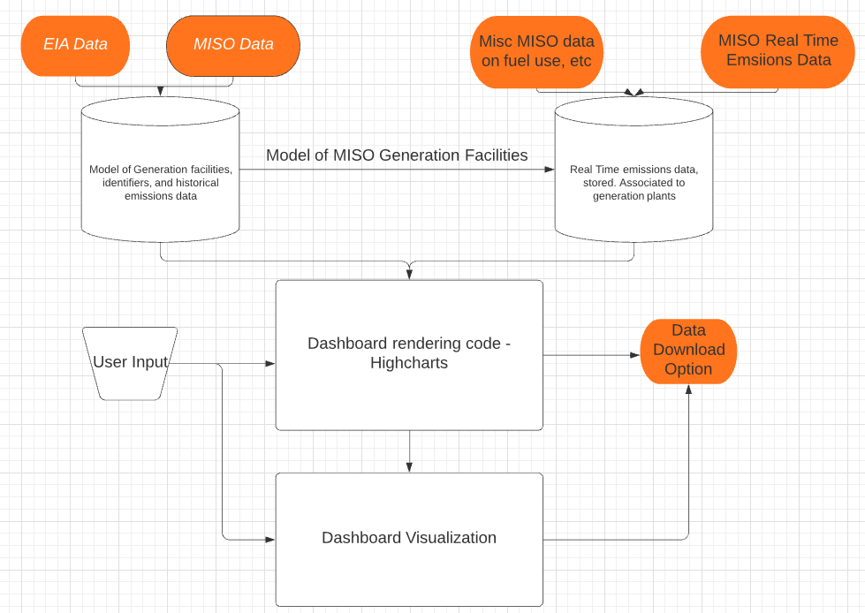
System Diagram

Slide 4
Interface Testing
Automatically test data source interfaces (APIs, EIA info, etc.) within software
Calculations and data manipulation will be done using test dataset(s)
Language to language interface testing using unique identifier codes and test dataset(s)
Data import and manipulation to graphing library will be verified with test dataset(s)
Interface between final dashboard and graphing code will be verified with test data from real time and historical data sets
User to system interfaces will be tested by various groups: team, customer, other students
Notes:
Dylan: just read the slide

Slide 5
Integration Testing
Assumption Development -Discussions with stakeholders highlighted the need for estimation and assumptions. One example is, if a generator in the MISO region also feeds power into a different ISO, we will assume it is only feeding the MISO region).
Data - Data will be gathered from public sources including MISO website, the EIA (Energy Information Administration), additional public sources.
Software Development - We will be using Python, JavaScript, and HighCharts. Dashboard requirements include having both recent and historical data display options (line charts, regional map view), the ability for the user to filter by region and download raw data.
Documentation - The final step will be checking to see if all visual aspects are implemented and write a report documenting any conclusions we came to.
Notes:
Dylan: read the slide
Multiple modules we need to integrate: The assumptions, calculations, and data manipulations we use to create the dashboard, the data gathering modules, forcing the different software languages to play nice with each other, along with documenting the major integration tests for customer reference.

Slide 6
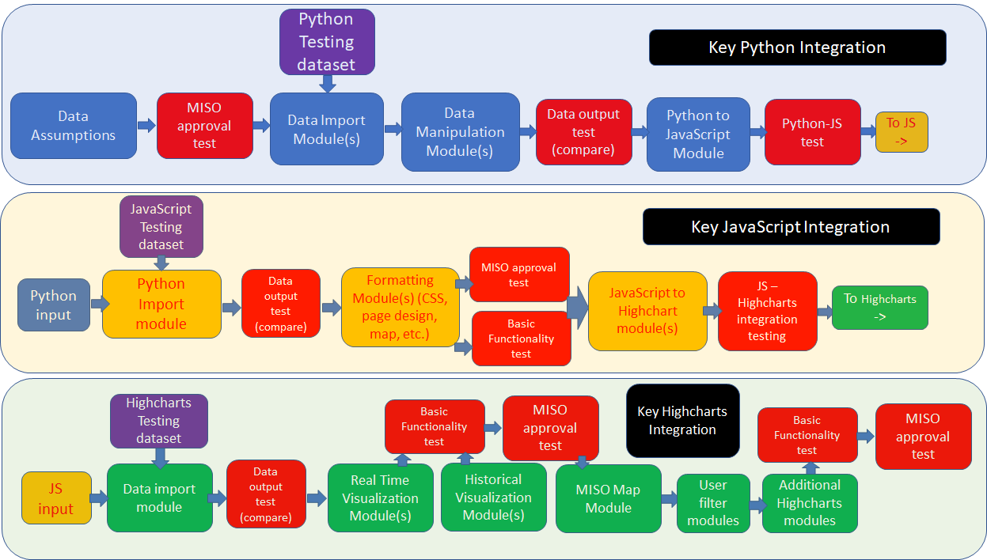
Integration Testing
Notes:
Here is ideation of how some of the integration testing could happen. The modules are broken down into three main groups: Python modules, Javascript modules, and Highcharts modules. WIthin each group are some of the individual units that need to be integrated and some test that could be performed. Not necessarily linear.

Slide 7
Unit Testing
All imported data sections will be compared to their parent datasets
There should be a match between the source columns and extracted data
Dashboard unit testing will consist of software unit testing of our Highcharts library implementation

Slide 8
System Testing
Can break down the system into three separate steps, analyzing the inputs and outputs of each step:
Pulling data from data sources
Here, the data should be pulled from a static number of sources and the data pulled will send the most recent information from these data sources for data processing
Data processing
For data processing, information will be sent here from the previous step and will output data that can be easier read by the user or consumer of this data
Visualization
There will be a large number of inputs that come from the data processing step alongside user input on the web page itself, which will determine the output of the desired graphs and trend lines displayed.
Linking all of these steps together will be key to testing the system, and changing variable inputs and seeing how they affect the output will be necessary
Notes:
Jack’s slide

Slide 9
Regression Testing
Critical Components:
Capability for data to be sourced directly to the emissions dashboard for daily updating of interface
Interactibility with the user including publicly sourcing information so general user can access the dashboard
Ensuring that these two components do not break, proper documentation of code along with communication of new features must be cross checked with already processed code to update features

Slide 10
Acceptance Testing
Create a UAT(User Acceptance Environment) for stakeholders to test the MISO dashboard.
Stakeholders will test software relative to the predefined business requirements and constraints.
Functional and non-functional requirements will be assessed.
Any requirements not adequately met will be redeveloped and reassessed by MISO stakeholders.
Notes:
Dylan:
Our customers want to assist us in the development of the project, and since it is software based it is easy to share “prototypes” with our customer. So there will be multiple points of acceptance testing during the project, along with final acceptance test(s)

Slide 11
Results
Maintain data quality between processing operations
Ensure correct data is output to dashboard
Dashboard interactivity is suitable for end users
Overall functional requirements are met

