Slide 1
System sketch

Slide 2
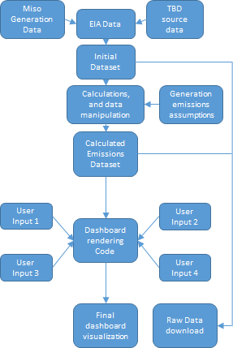
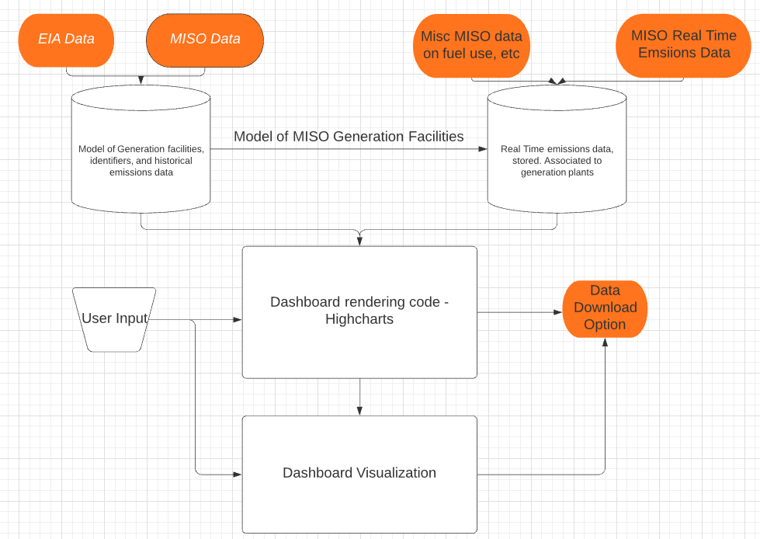

Slide 3
Additional Data Source(s)
Generation Fuel Mix Data (MISO) + Emissions data https://www.misoenergy.org/markets-and-operations/real-time--market-data/market-reports/#nt=%2FMarketReportType%3ASummary%2FMarketReportName%3AGeneration%20Fuel%20Mix%20(xlsx)&t=10&p=0&s=MarketReportPublished&sd=desc
Historical Generation Fuel Mix Data (MISO) + EIA Emissions Data https://www.misoenergy.org/markets-and-operations/real-time--market-data/market-reports/#nt=%2FMarketReportType%3ASummary%2FMarketReportName%3AGeneration%20Fuel%20Mix%20(xlsx)&t=10&p=0&s=MarketReportPublished&sd=desc
EIA Data (plant location, etc.) https://www.eia.gov/electricity/data/eia923/
RT Generation Data scraper
Historical Generation Data scraper
EIA Data scraper
Additional scrapers
Key functions:
-Verify source
-Parse out fuel mix type, region, and amount
-Store raw data for user download
Key functions:
-Gather MISO generator information:
-Plant location, type, historical production, etc.
-Format for combination with MISO datasets
Key functions:
-TBD
Scraped, formatted RT Fuel Mix/ Emissions Data
Scraped, formatted Historical Fuel Mix / Emissions Data
Scraped, formatted EIA Data
Highcharts Graphing library/ Dashboard
Collected source data combination function.
Key functions:
-Combines EIA and MISO data into 1 (or 2) datasets
-Formats data for assumptions, calculations, etc

Slide 4
