Slide 1
Team 15 - MISO Emissions Dashboard
Daman Riat , Dylan Christensen, John DiBasilio, Sean Fleming, Jack Riley, Tyler Maglaya, Manbir Guron

Slide 2
The Problem Statement
Team 15 is tasked with creating an emissions dashboard for MISO (Midcontinent Independent System Operations).
MISO stakeholders lack a fast and efficient way to analyze public emissions data generated by MISO.
Stakeholders of MISO will be the main users of this dashboard. A stakeholder is anyone outside of MISO, that interacts with the company.
The dashboard must be interactive, user-friendly, and provide helpful graphs and visuals.
This dashboard will allow users to understand the emissions impact of the energy generation and consumption, and create context behind complex trends in data.

Slide 3
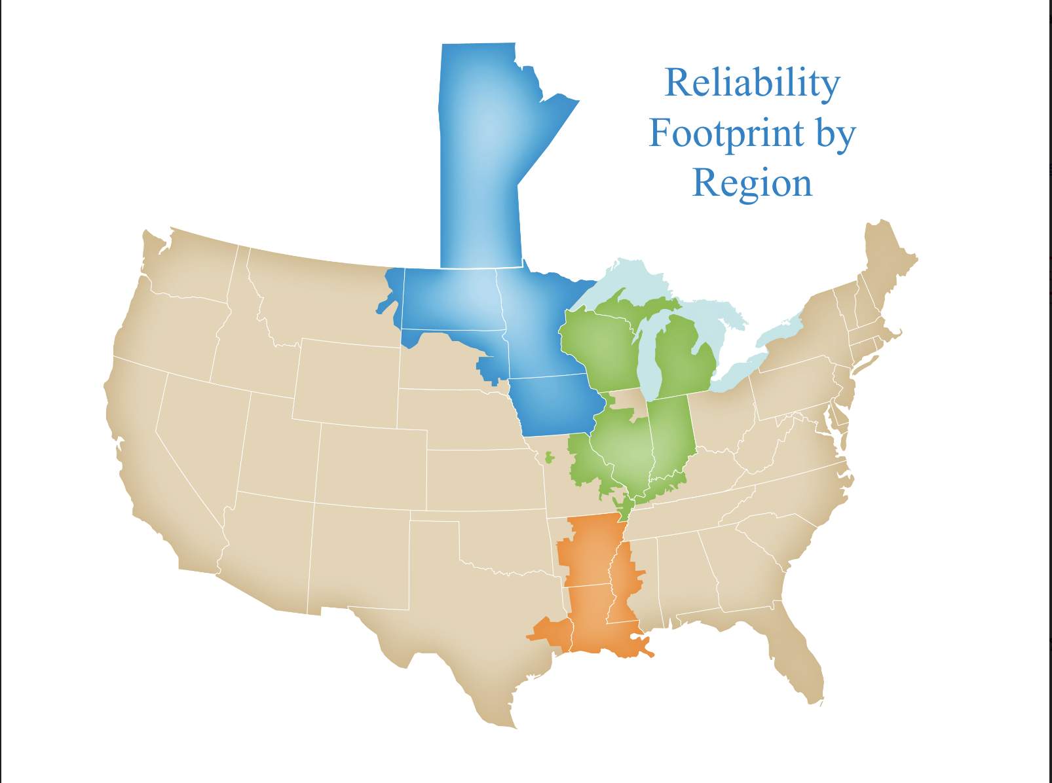
Requirements
Interactive chart of daily emissions by region
Filter by region, generation type, time of day, etc
Allow different visualization options
Allow user to download their data visualization
Generate report using our data to contextualize MISO emission trends
Maintain consistency with MISO visual and data management standards

Slide 4
Constraints
Maintain MISO brand standards and UX standards
Dashboard needs to be user friendly with the same look and feel of other MISO dashboards
Use open source / software with existing licenses
This could limit some options or lengthen some tasks
Maintain consistency with industry standards
Product might be used to focus investments and needs to accurately reflect the data
Use publicly accessible data
May require some additional approximation in final data

Slide 5
Engineering Standards
IEEE Std 1063, Standard for Software User Documentation. Minimum requirements for the structure, information content, and format of user documentation, including both printed and electronic documents used in the work environment by users of systems containing software, are provided in this standard
IEEE Std 1220-2005, Standard for Application and Management of the Systems Engineering Process. This standard describes the systems engineering activities and process required throughout a system's life cycle to develop systems meeting customer needs, requirements and constraints.
IEEE 16326:2019 This standard gives content specifications for project management plans that cover software projects and describes applying sets of common project processes to software and system life cycle.
IEEE 23026-2015. This standard describes the system engineering and management requirements for life cycle of websites, including the strategy, design, engineering, and testing and validation and management for the Intranet and Extranet environments. Project will be a website hosted dashboard so it will be useful in some of the information it provides.

Slide 6
Intended Users and Uses
The intended users of the dashboard are individuals in the public who are interested in seeing some of the environmental impacts of energy generation across MISO territory. This will include:
MISO
MISO Stakeholders
General Public
Customers of MISO
There will be different interactive data visualizations through which they can look at historical trends and overlay different groups of data.
The design of the dashboard allows anyone to observe key trends regarding the impact of emissions generated by MISO

